Slide 1
Glove for Deaf
BY:
Samira Mostafa Mater
Shahd Yasser Abdelhalim
Fatma Ashraf Fawzy

Slide 2
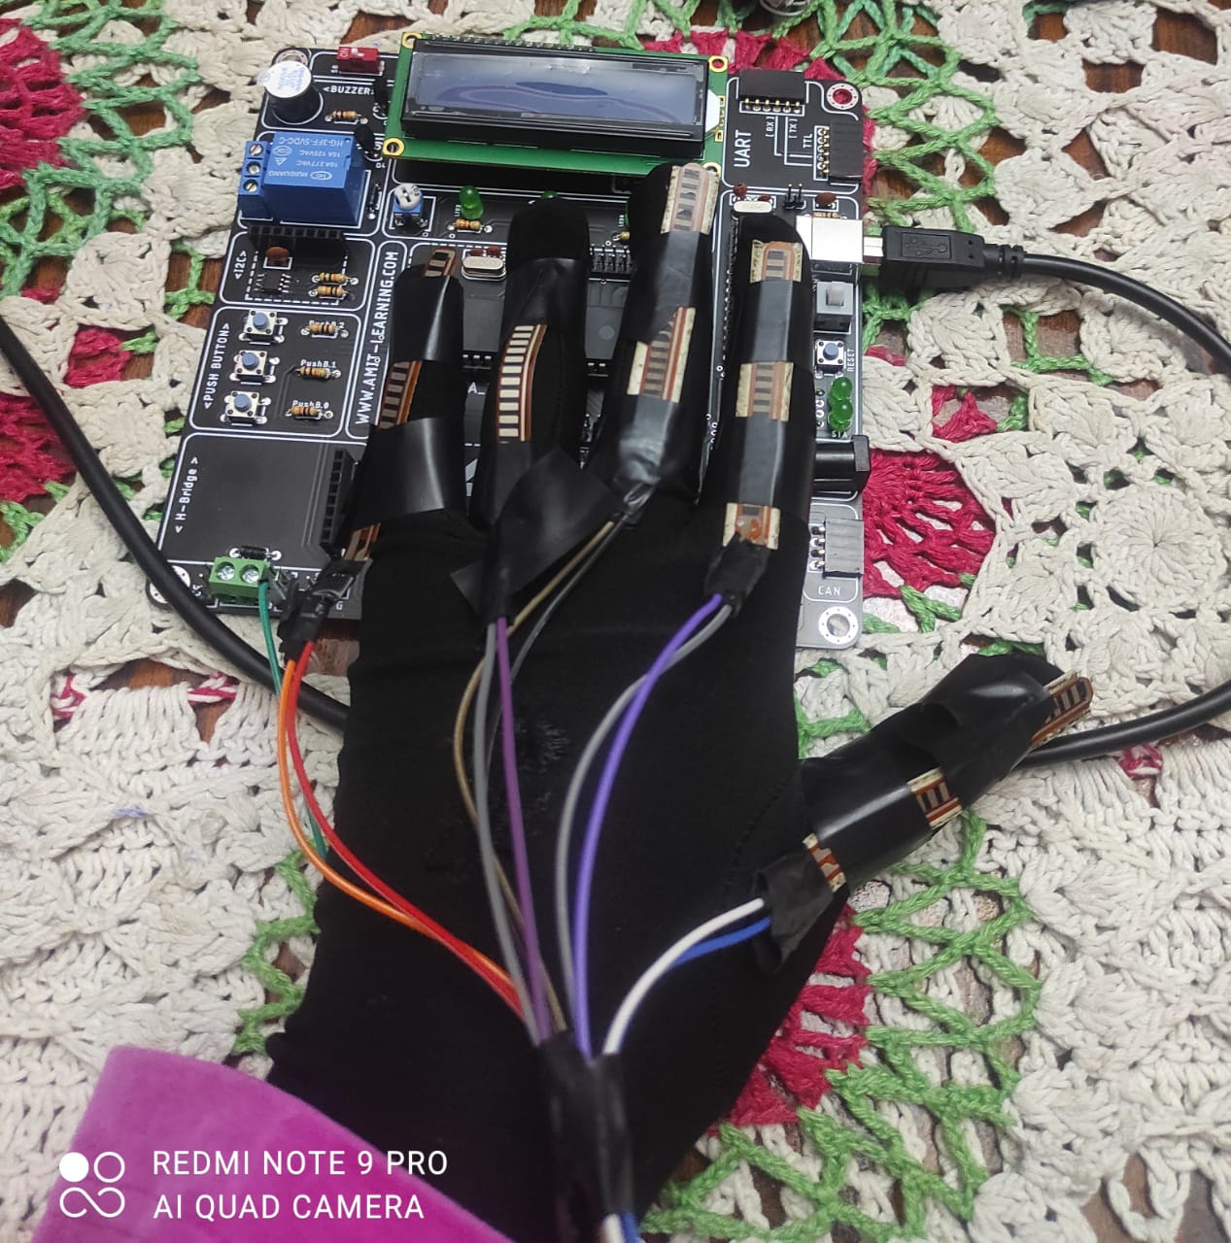

Slide 3
Introduction
A glove which could be worn by a deaf-mute person.
The glove will help the deaf-mute person translate his/her sign language into text which could be visualized by people without a disability.
Help deaf-mute people integrate into society.

Slide 4
Tools
5x flexible sensor.
Gloves.
Wires.
LCD.
External EEPROM
Micro Controller

Slide 5
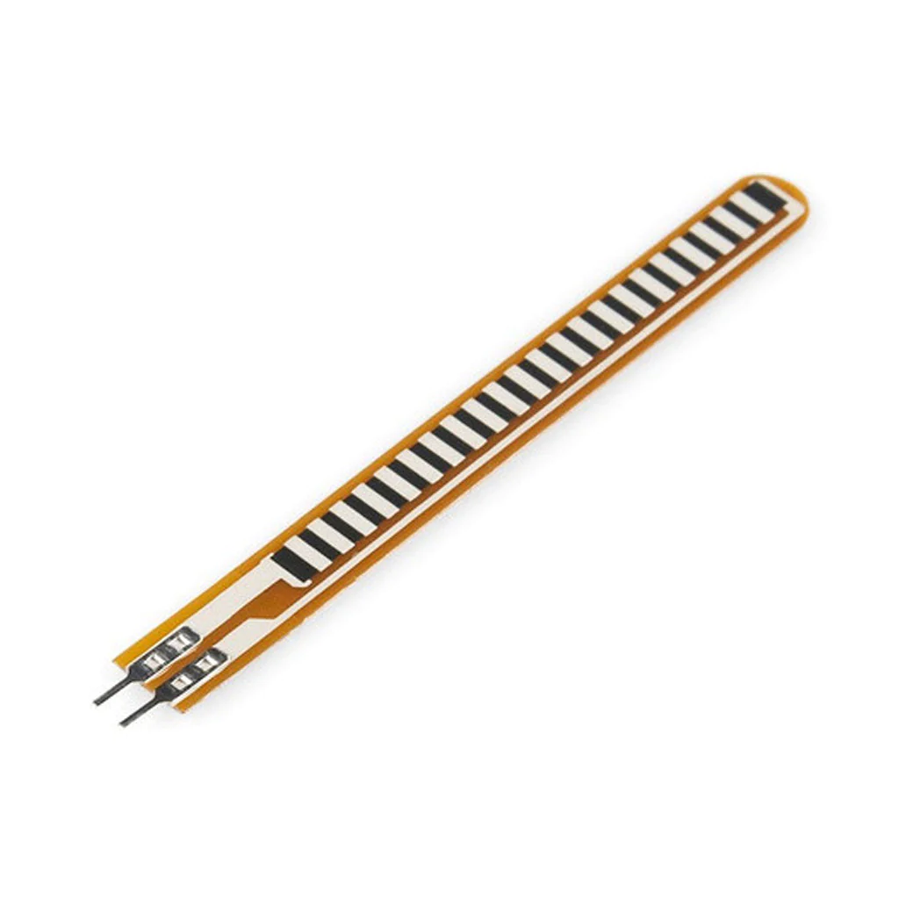
Flex Sensor
The flex sensor changes its resistance when flexed so we can measure that change .

Slide 6
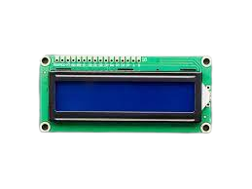
LCD
We used LCD to display the letters

Slide 7
External EEPROM
We used External EEPROM to store words

Slide 8
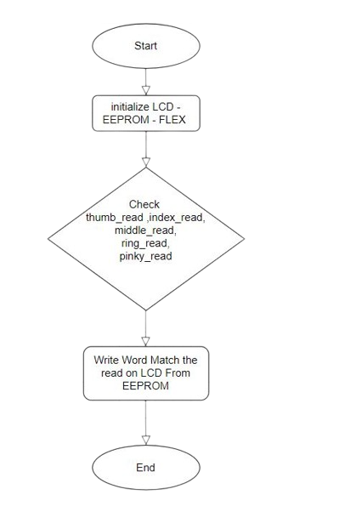
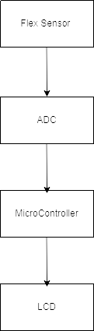
How It Works

Slide 9
Words
I’m Watching You
You
Really I Love You
ILOVEYOU
This Is Terrible
Good Job
OK
I’m Not Sure
Question
Welcome
Good Bye
I
W
L
7

Slide 10

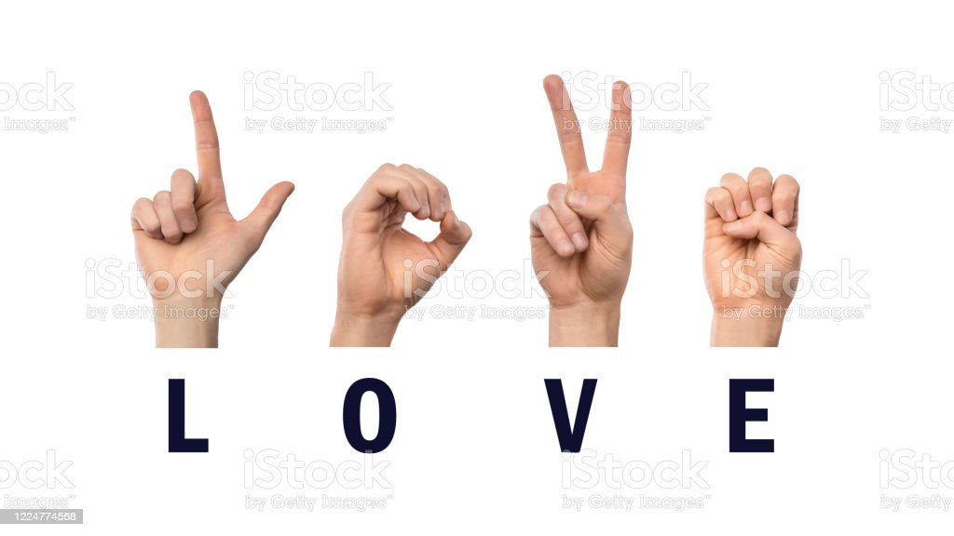

Slide 11
THANKS

